Slide 1
Publishing options: Spanish institution associated authors

Slide 2
Key information
How do we determine eligibility of the article for the Spanish agreement?
The acceptance date of the article should be on or after 1st January 202X
The corresponding author must be affiliated with the participating Spanish institution or a faculty/department
The article must be from an eligible journal

Slide 3
Key information
2. Role of the institutional librarian in the Elsevier OA Platform (EOAP)
By the time the article in is your EOAP, we have published the first version of the article in ScienceDirect (within 48 hours of acceptance)
You therefore are not approving the publication of the article, you are validating whether the corresponding author can make use of the APC fund as part of the agreement

Slide 4
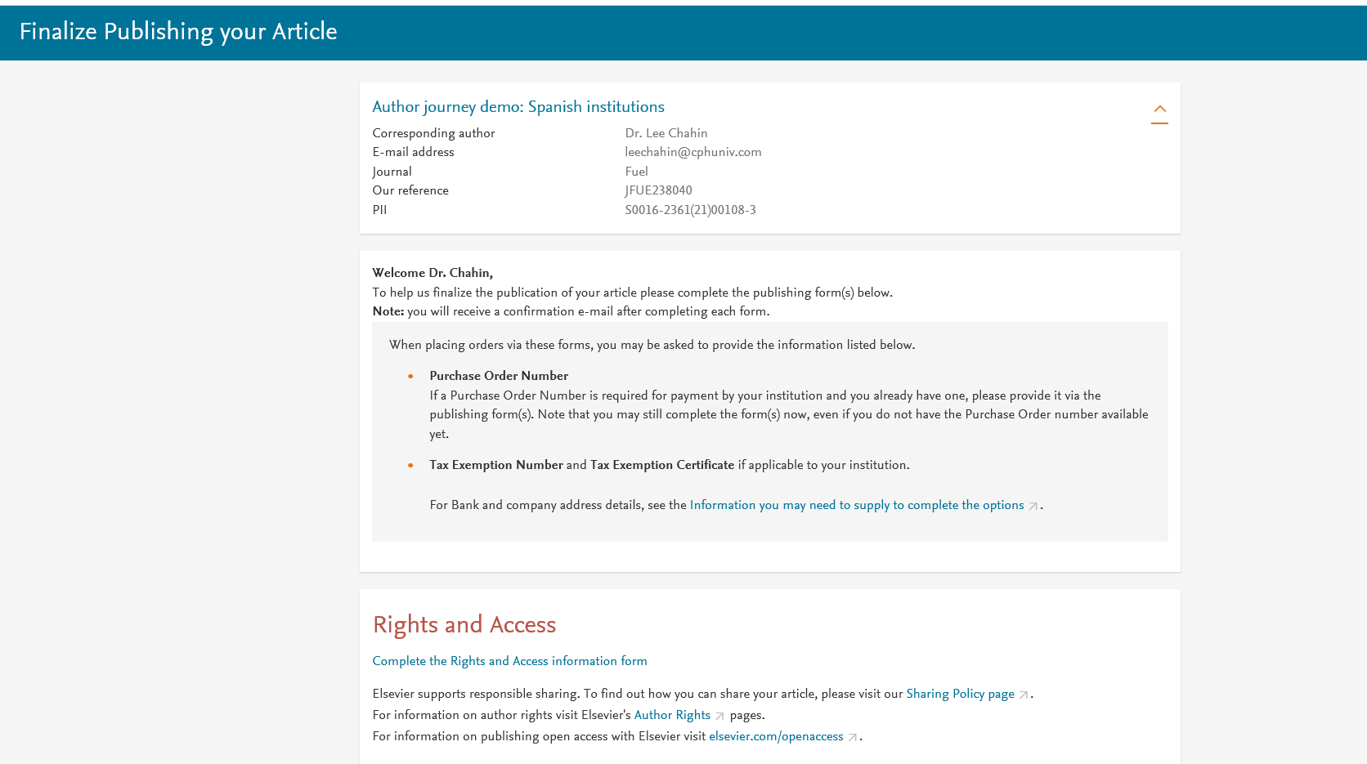
Corresponding author receives an email post acceptance with a unique link to complete the author journey and choose publishing options
Author clicks on Complete the Rights and Access information form

Slide 5
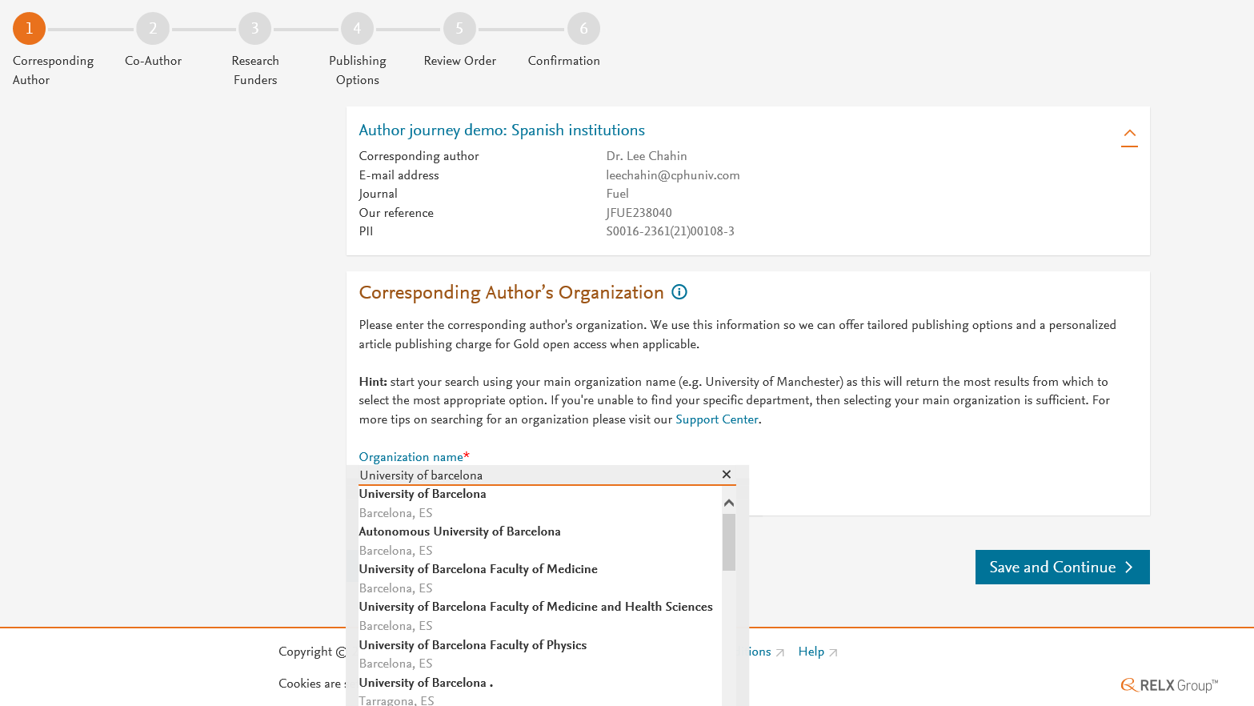
Corresponding author selects his/her affiliation details which we use to identify the authors and match them to the Spanish agreement

Slide 6
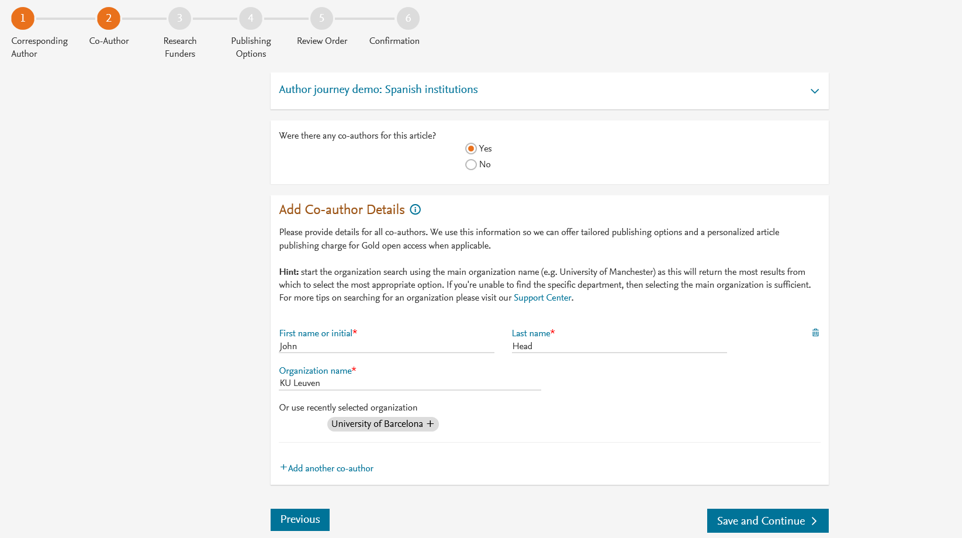
Corresponding author also adds the co-author affiliation details

Slide 7
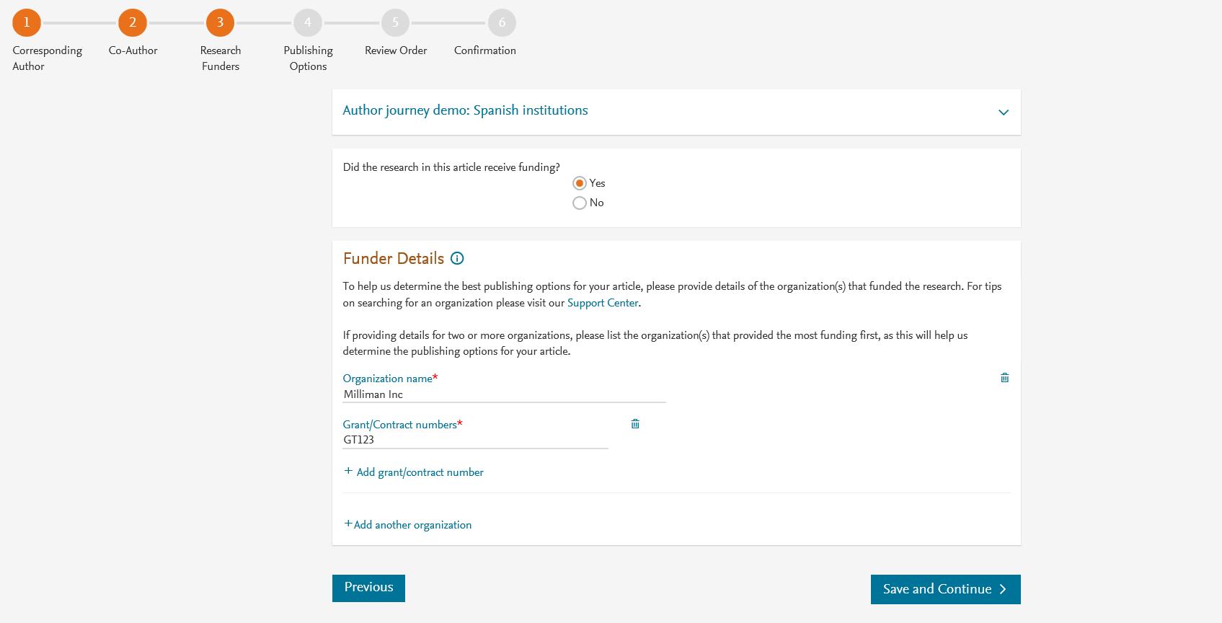
Author can add the Funder details. Funder can be the affiliated institute or a different one. In this case it is Milliman

Slide 8
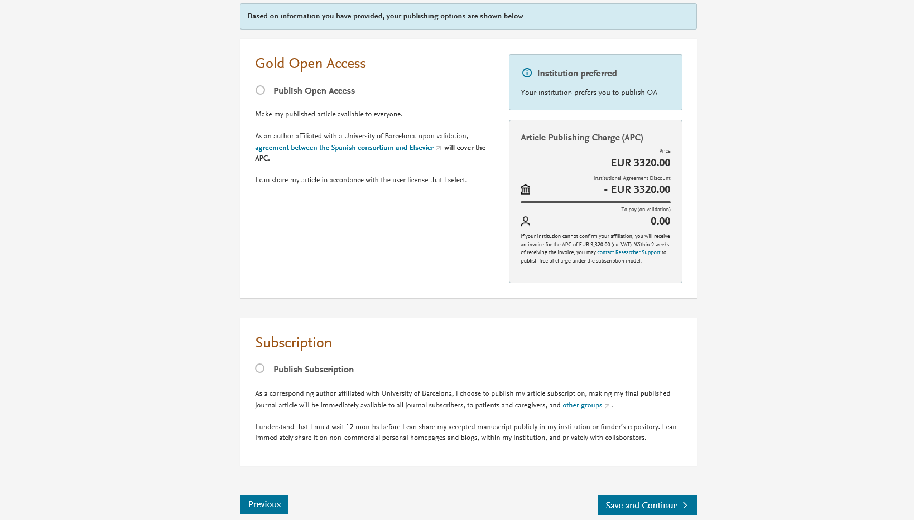
Personalized publishing options for the Spanish agreement

Slide 9
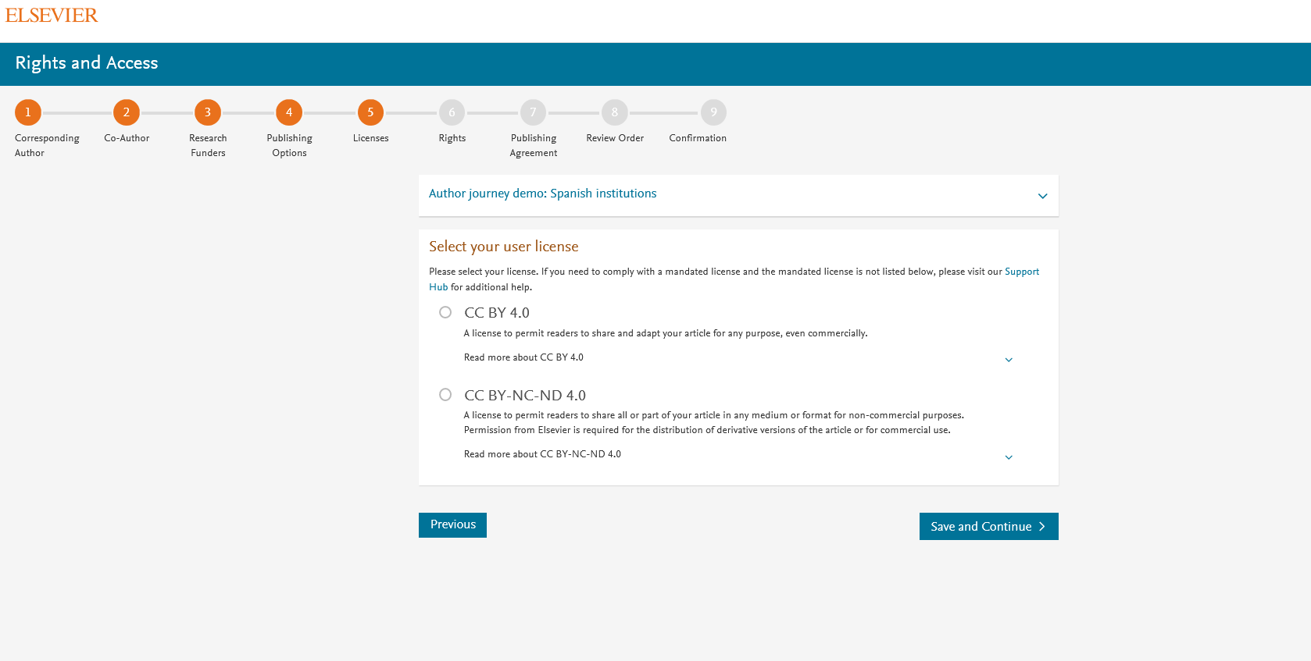
Elsevier offers two CC licenses for OA
Author selects the CC License

Slide 10
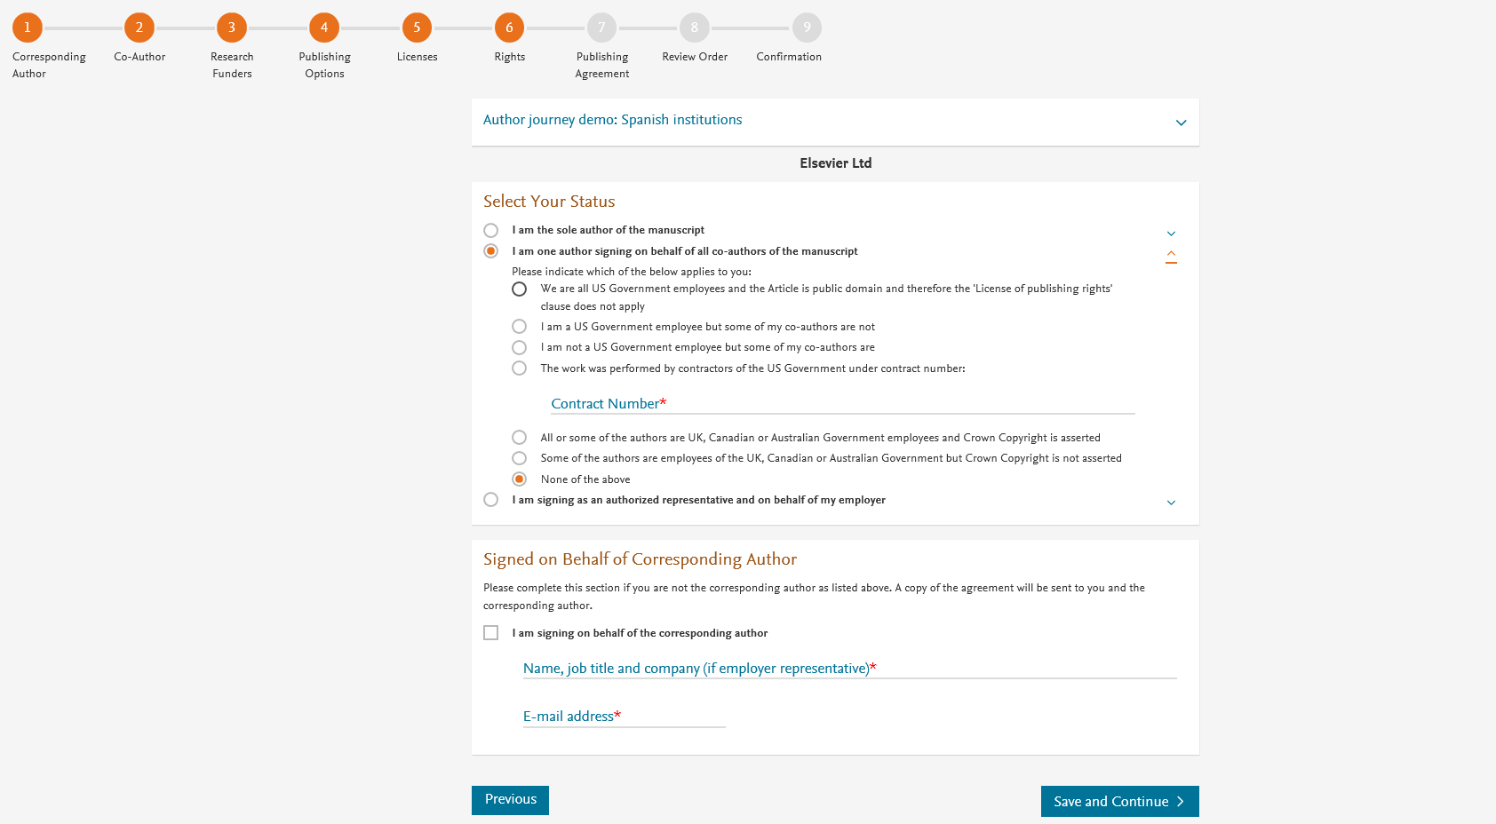
Author selects the rights

Slide 11
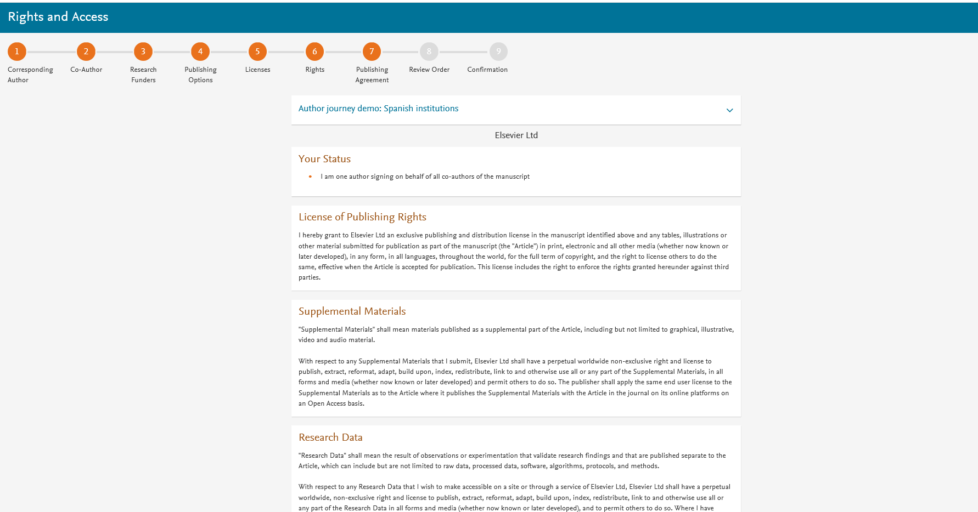
System presents author with the Journal License Publishing Agreement

Slide 12
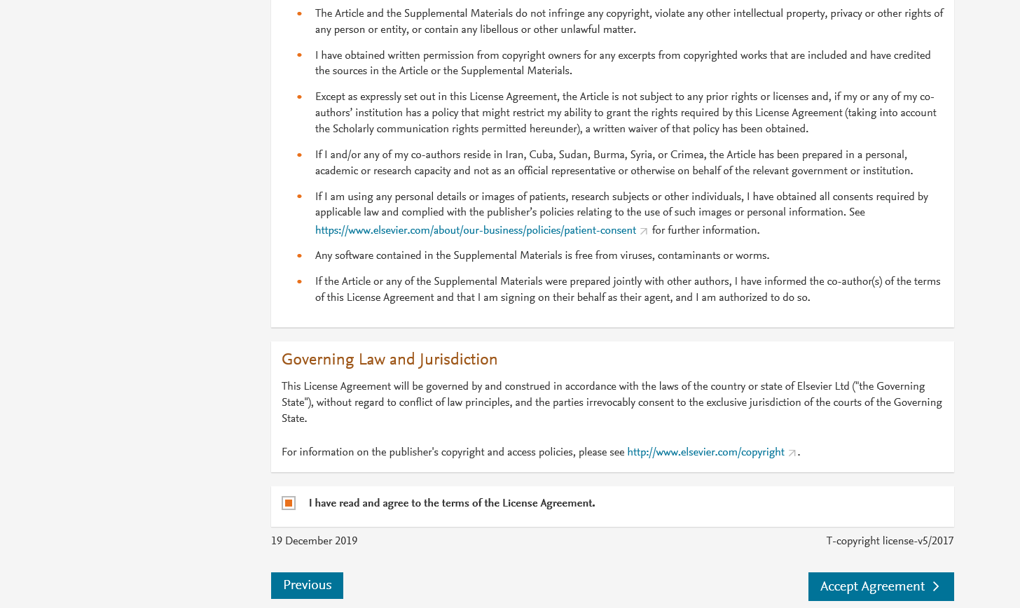
Authors agrees to the Journal License Publishing Agreement

Slide 13
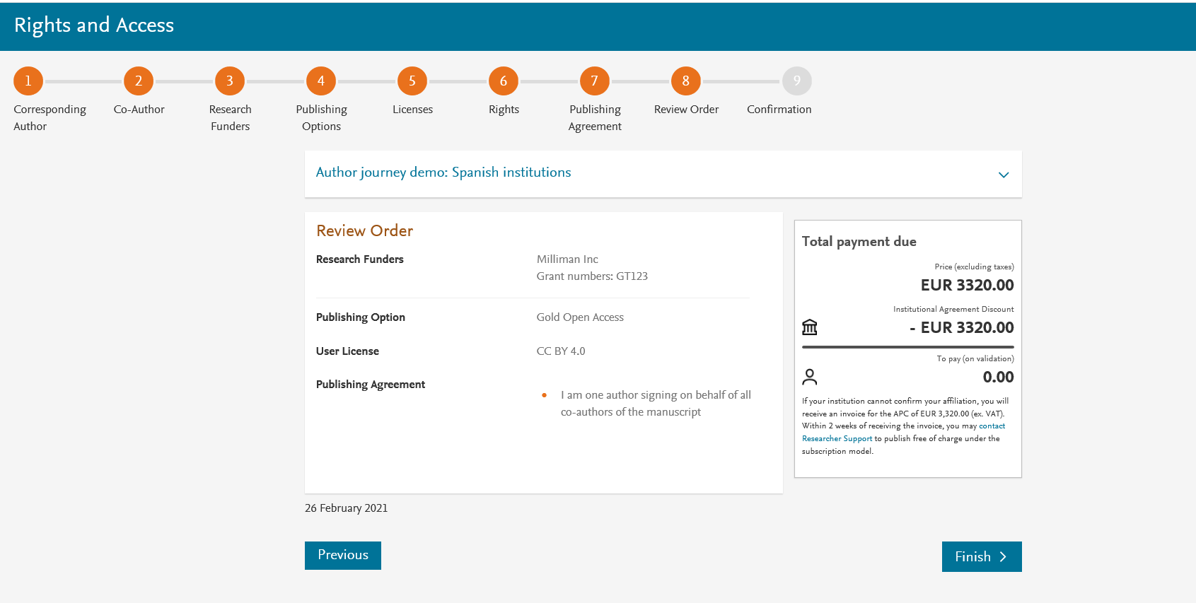
This is the summary page explaining the choices the author made in the publishing journey
Corresponding author and coauthors receive a copy of summary via email
Articles becomes OA on Science Direct within 24 hours
Librarian at the institute will receive a notification for validation within 48 hours who then has 3 weeks to complete the validation

